Slide 1
Vertical Farming
Patrick McNally & Gordon Rice

Slide 2
Overview
History - Who and When it was Conceived 3
Plan and Implementation - Who or What it will Impact 4-5
Upsides/Pros to the Advancement 6
Downsides/Cons to the Advancement 7
More Images
Summary 7 Are you for or against the advancement of this technology (even if your mind changed during the research)
References 8

Slide 3
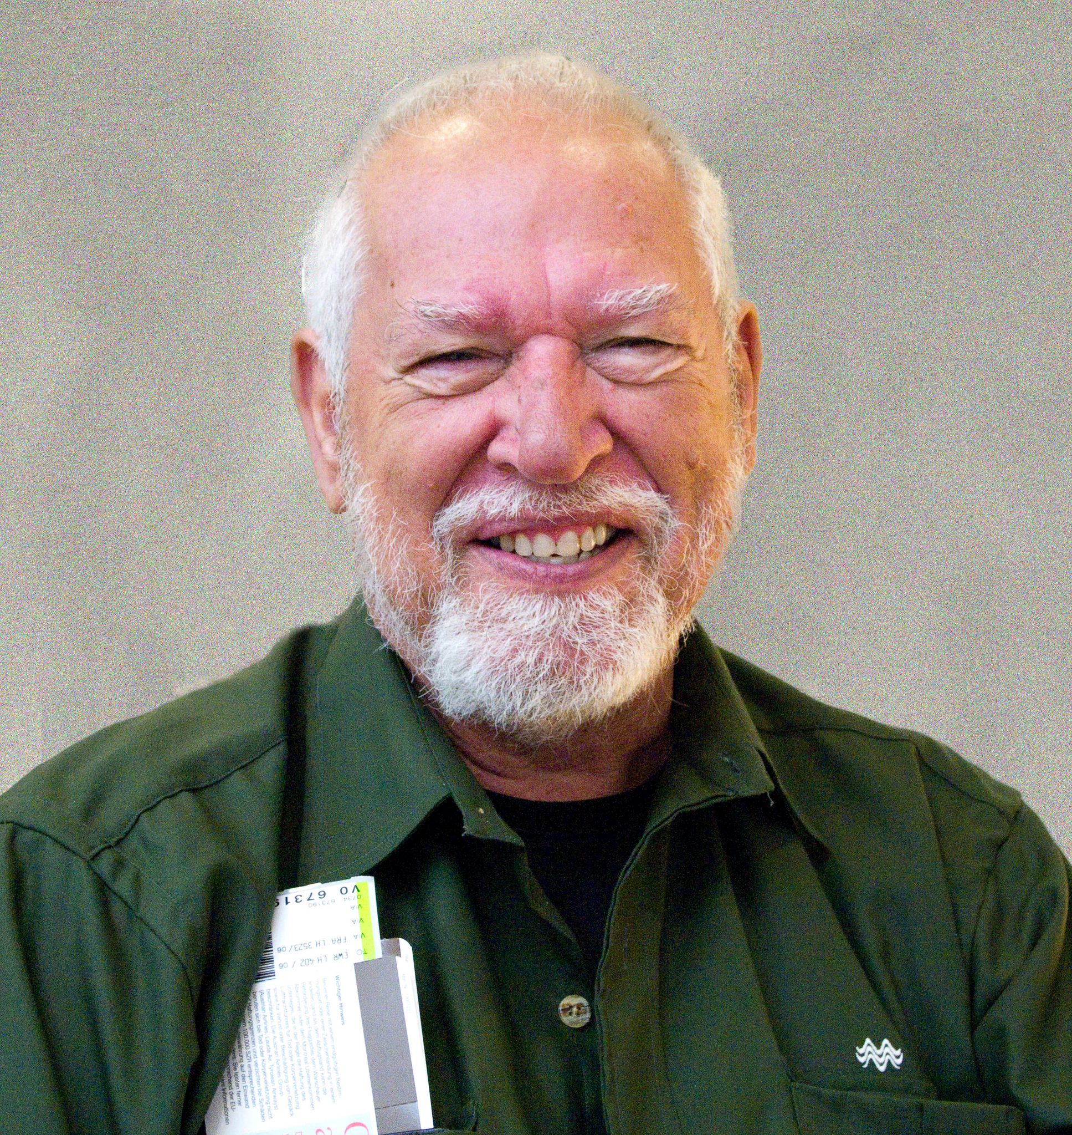
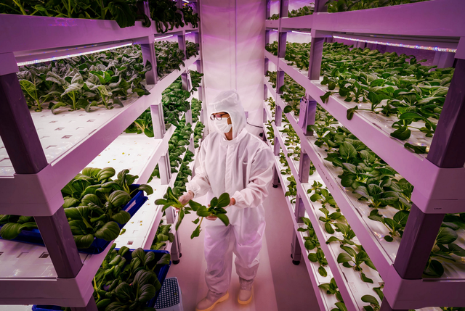
History
Who invented vertical farming?
-The term vertical farming was brought about by an American Geologist in 1915 named Gilbert Ellis Bailey
-In 1999 Dickson Despommier was the one who brought the vertical farming idea tp popularization among the agriculture community.
-Dickson is the founding father of vertical farming. He believes that we can help save world hunger and undo environmental damage cause by conventional agriculture.
Notes:
The inventor of Vertical farming was Gilbert Ellis but Dickson Despommier was the guy who brought the idea to life. He believes in vertical farming because of its environmental impacts.

Slide 4
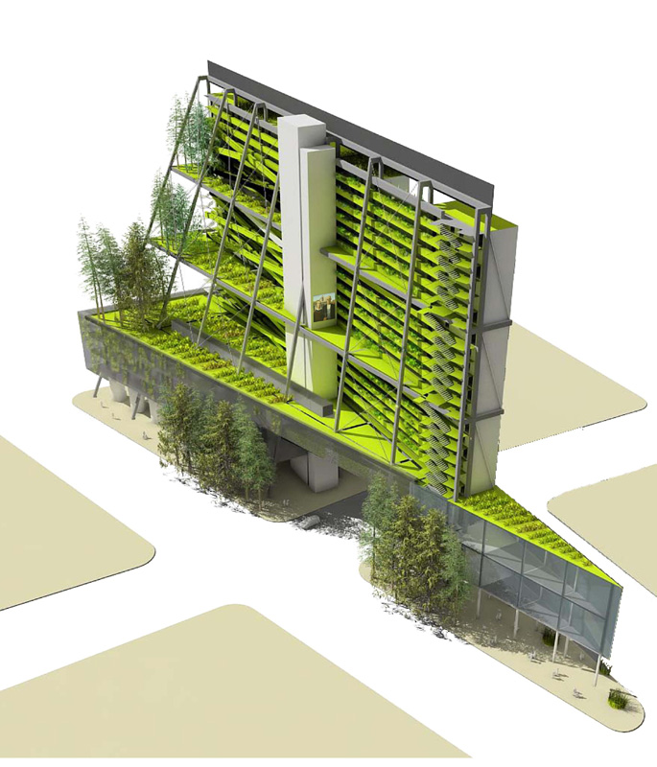
Implementation
Why it was created
The majority of the population lives in urban areas, vertical farms serve as an efficient method of agriculture that’s right there in the city! Food can easily be transported to grocery stores that are only a few miles away.

Slide 5
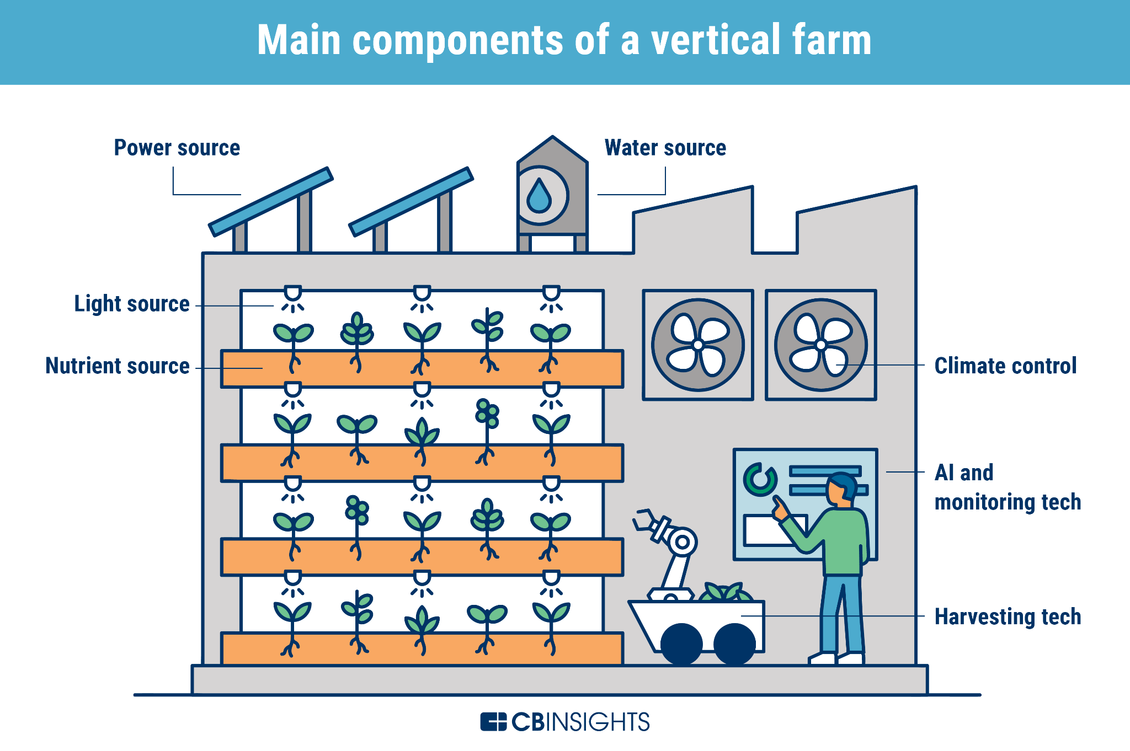
Basic Model of a Vertical Farm

Slide 6
Pros
Vertical farming consists of many important benefits.
It requires less space.
Because they are located in urban areas, it is much easier to transport goods
It uses less water.
Vertical farms can be in production all year.
It is a controlled environment without the risk of natural factors affecting the crops growth or production.
No animals
No Intense temperatures
No exposure to harmful chemicals and diseases

Slide 7
Cons
Despite having many benefits, Vertical farming also comes with some downsides
Some crops can’t thrive in these conditions. Not all plants can be grown using this method
Fossil fuels are still required for most because instead of sunlight, vertical farming uses LED lights. (Expensive initially)

Slide 8
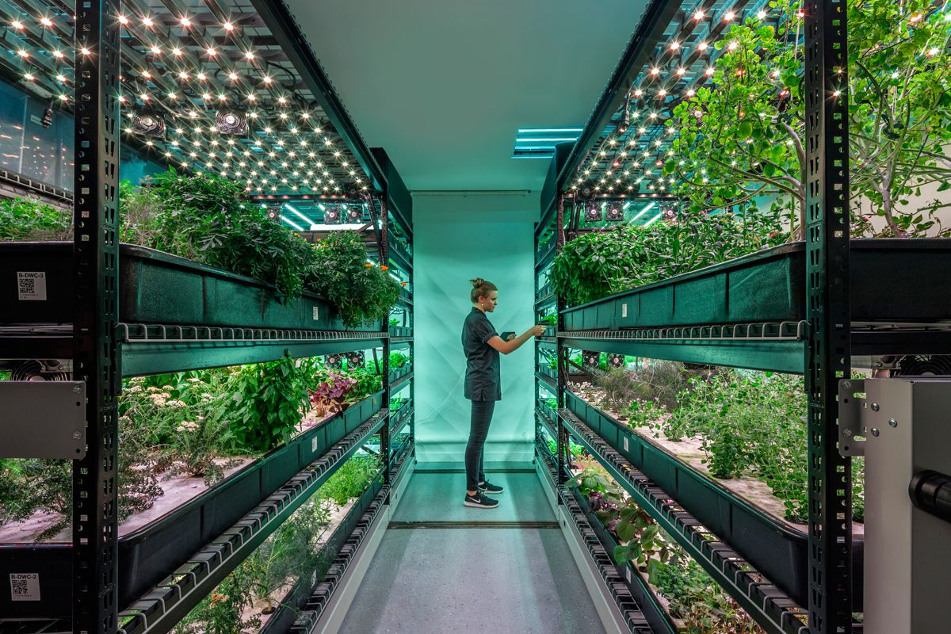
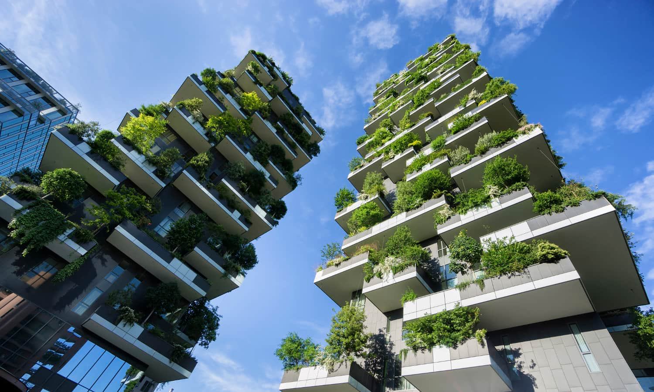
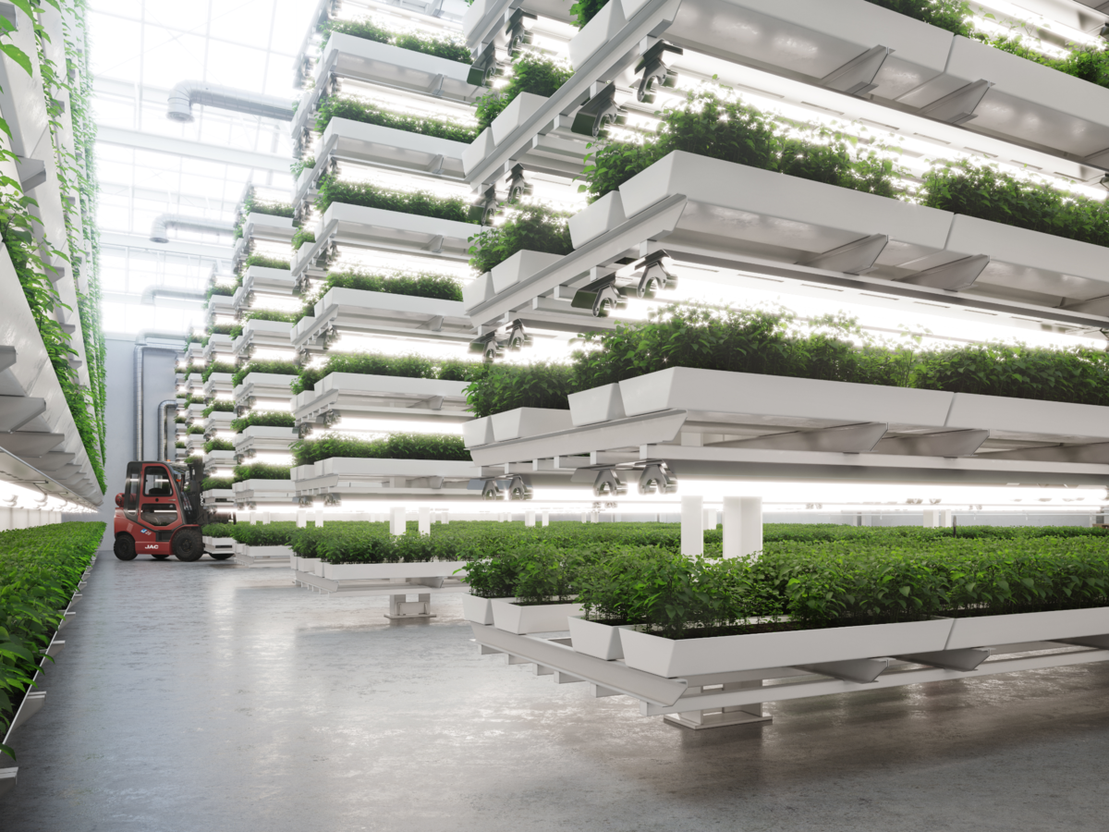
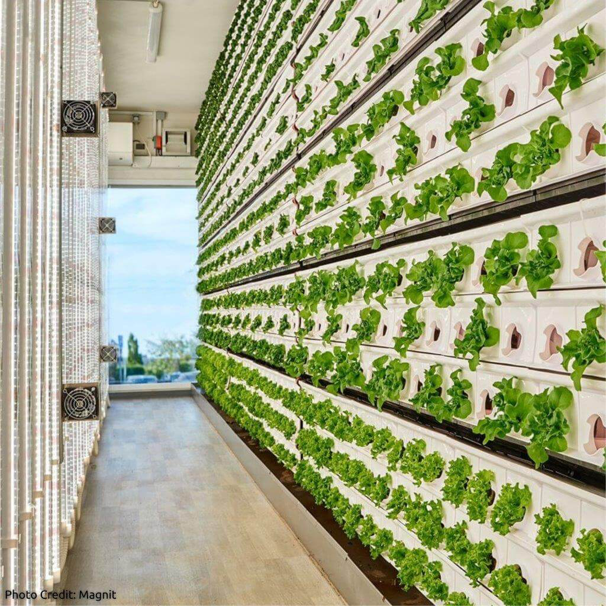
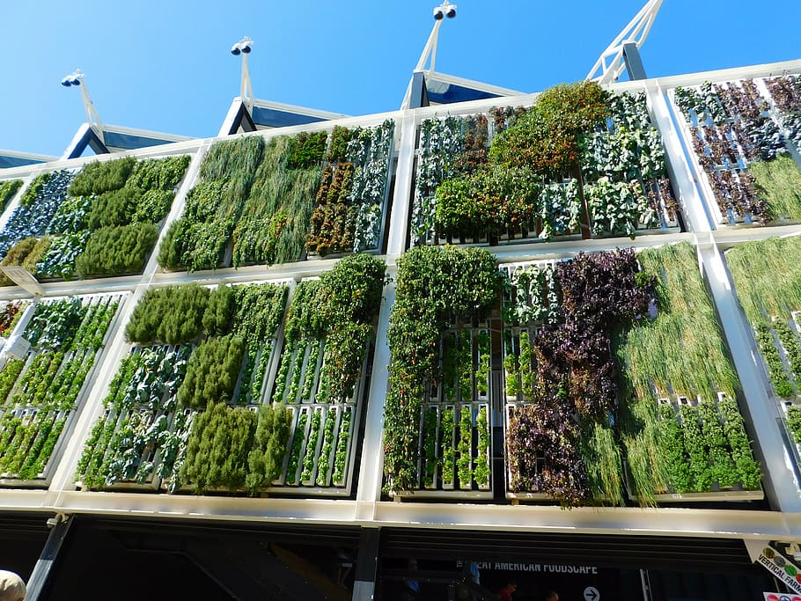
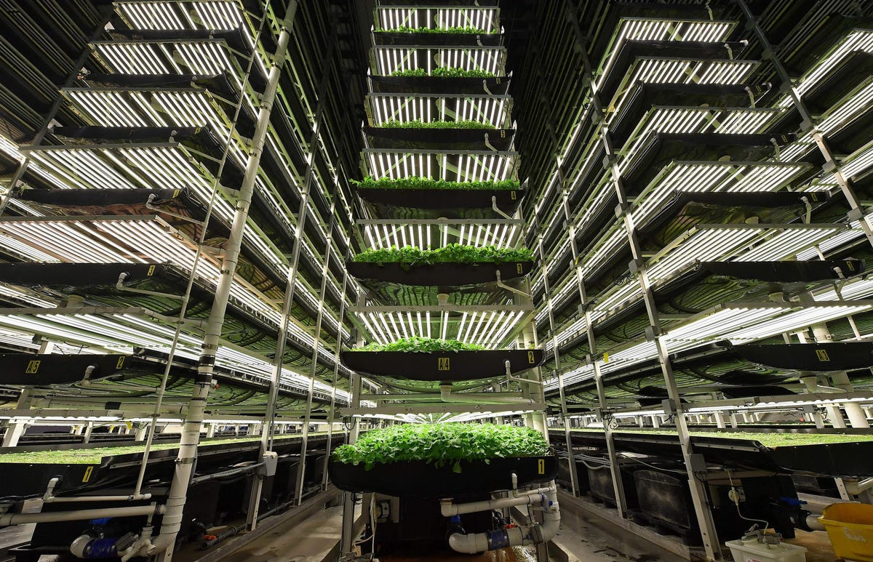

Slide 9
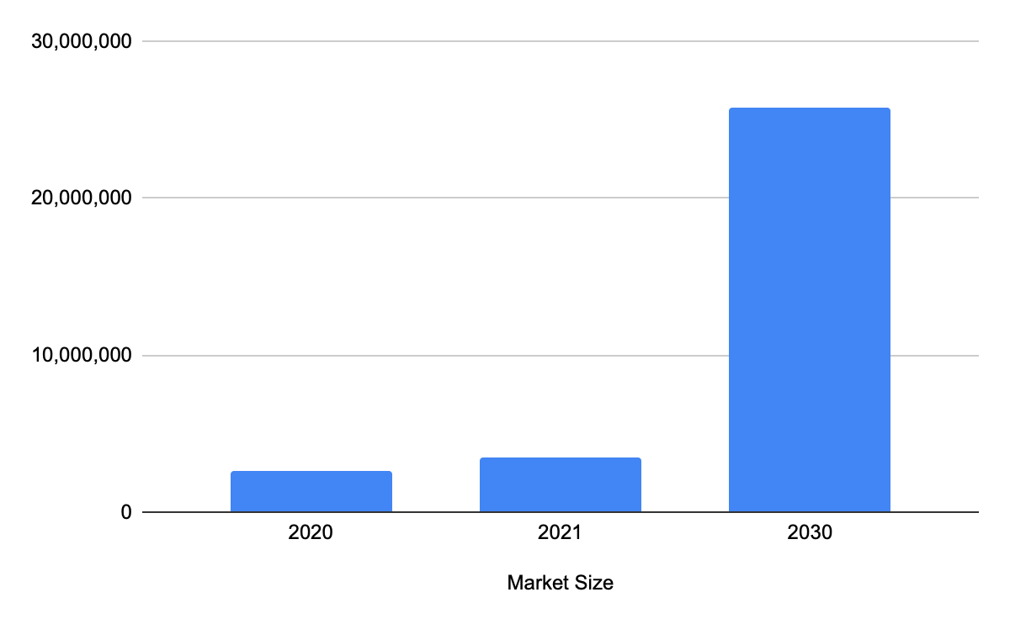
Expected Growth

Slide 10
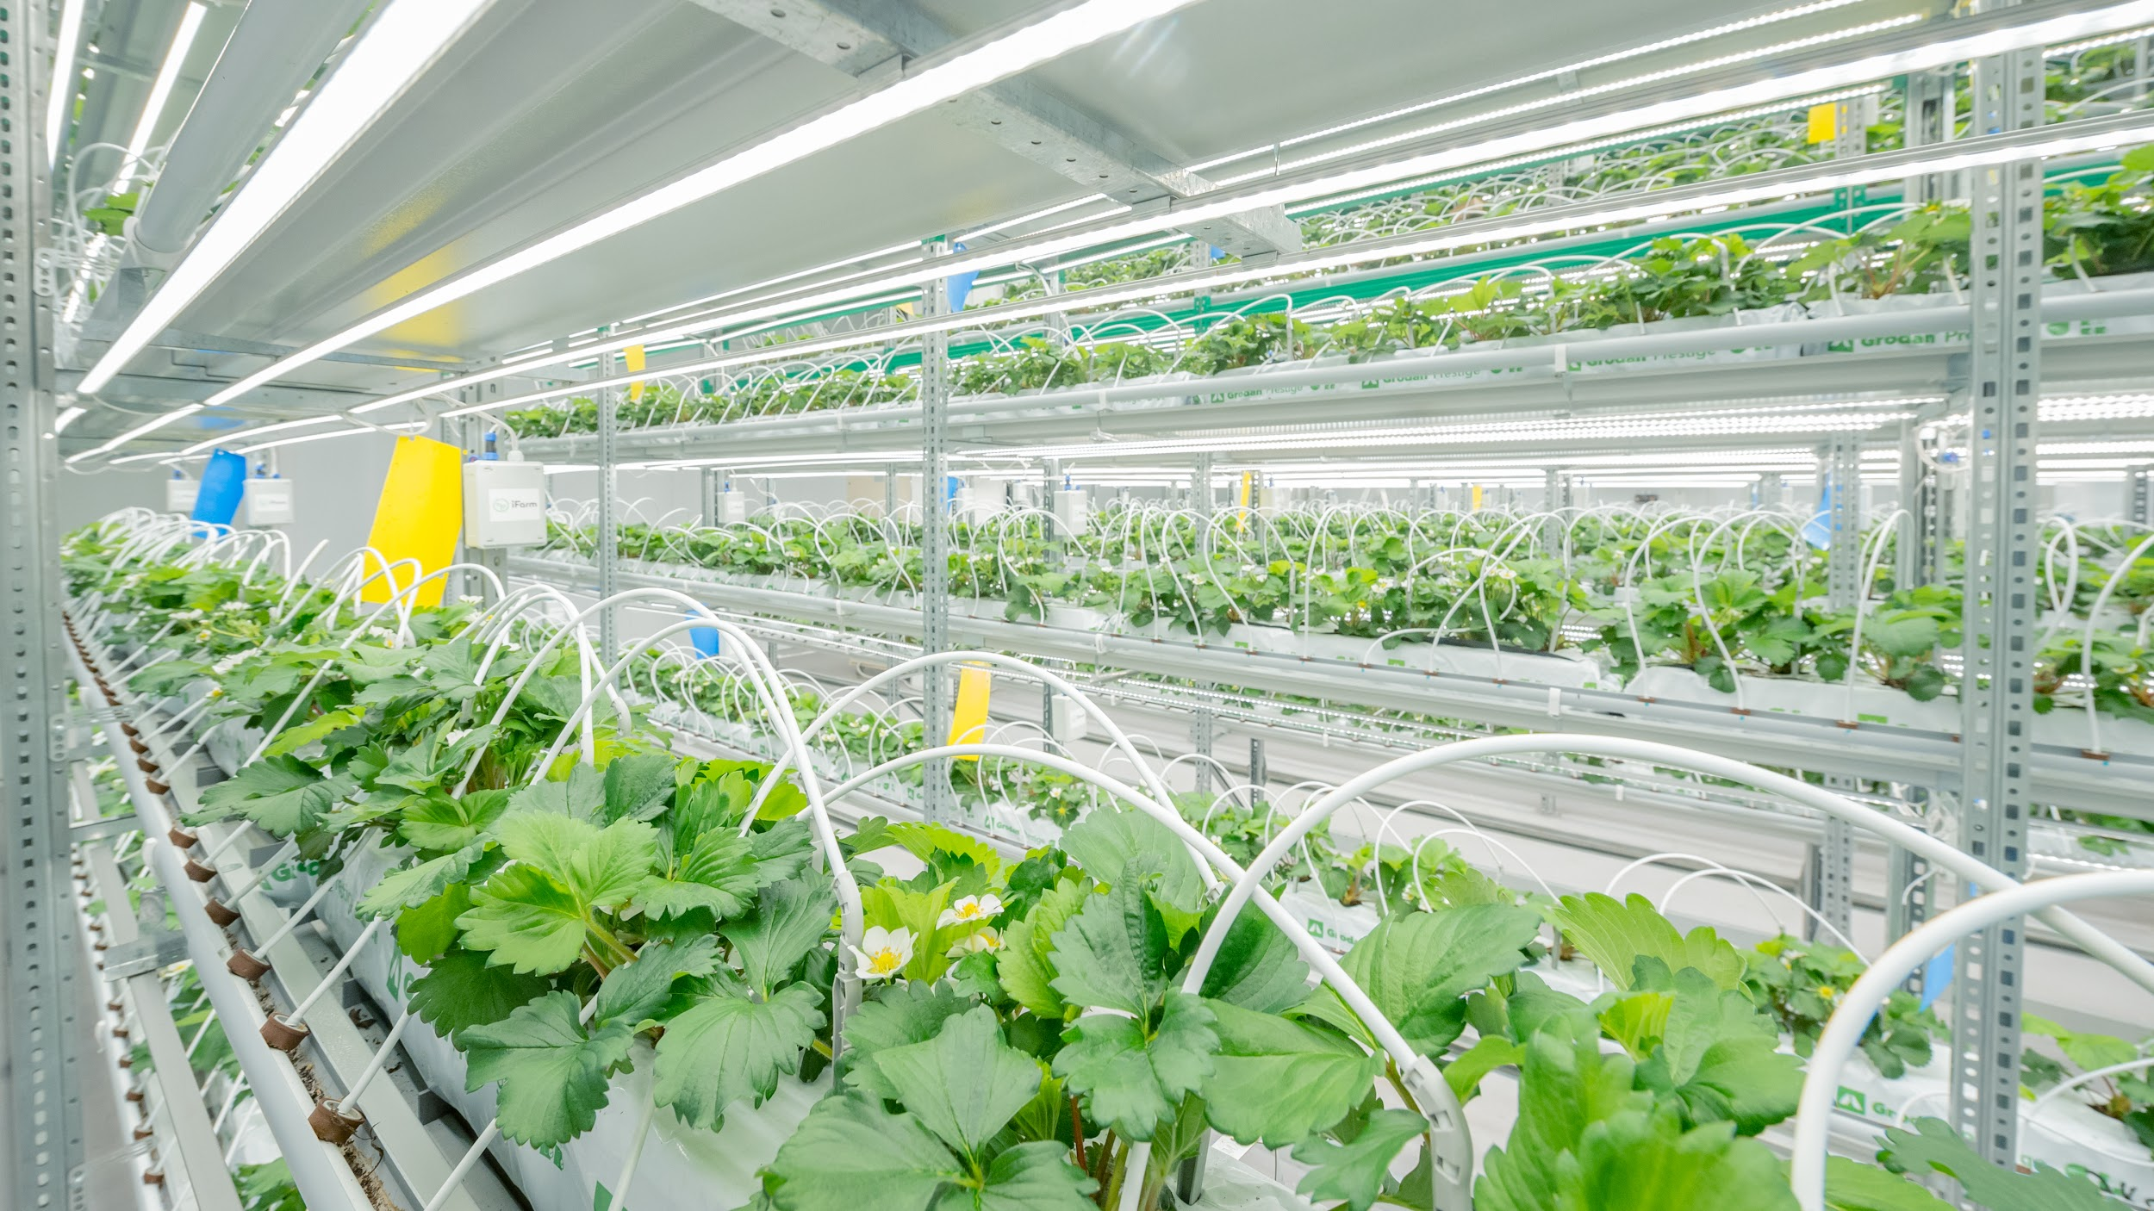
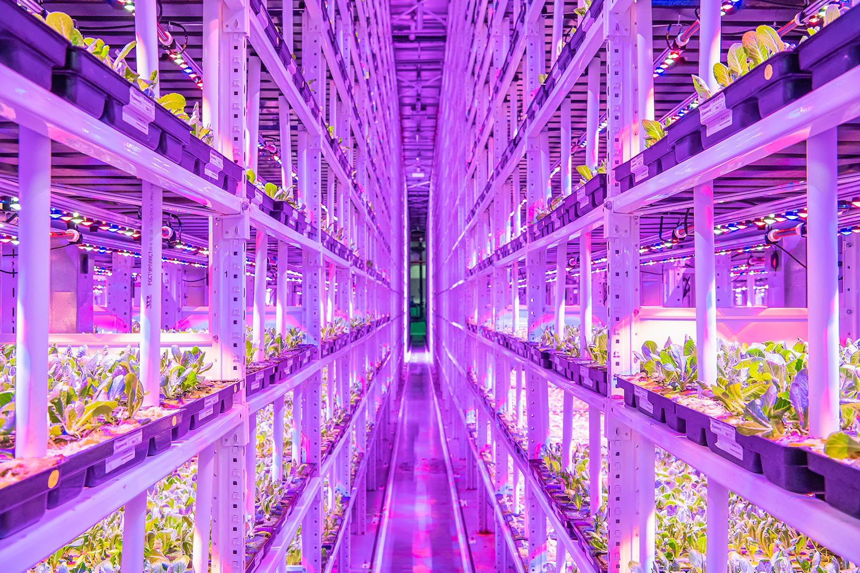
Summary
I believe that vertical farming would become a very profitable and environmentally friendly solution to our climate change problem. Although this style of farming is very expensive I think that saving our Earth is worth the price.
Some examples would be…
-These farms can grow more food in a smaller area.
-They can feed more people on average
-They help save our earth through minimization of water and resources
-And finally leave less undeveloped land due to its spatial capacity

Slide 11
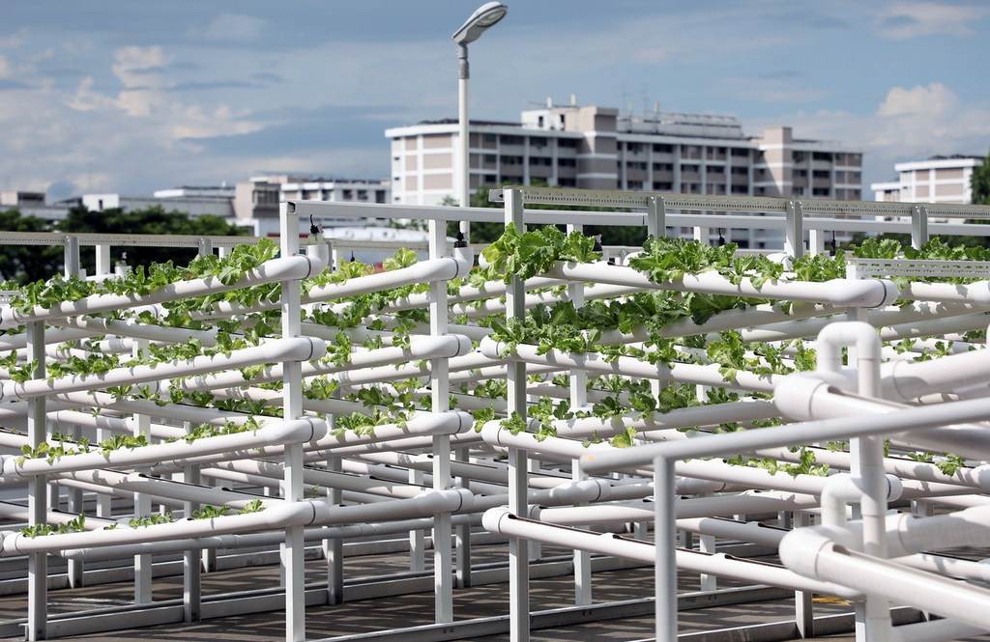
References
Vertical Farming: Everything you need to know Eden Green
Up, Up & Away: Vertical farms, The pros and cons Cleantechnica
Vertical Farms From Vision to Reality Columbia Climate School

